Slide 1


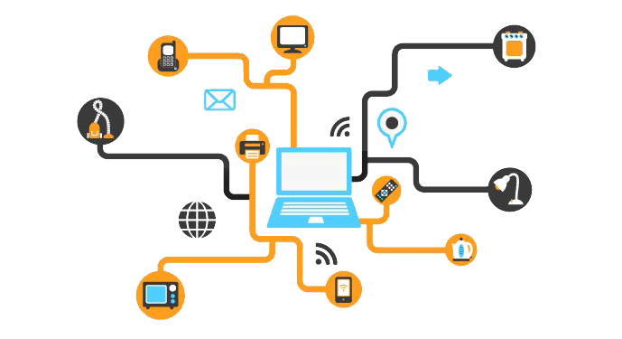
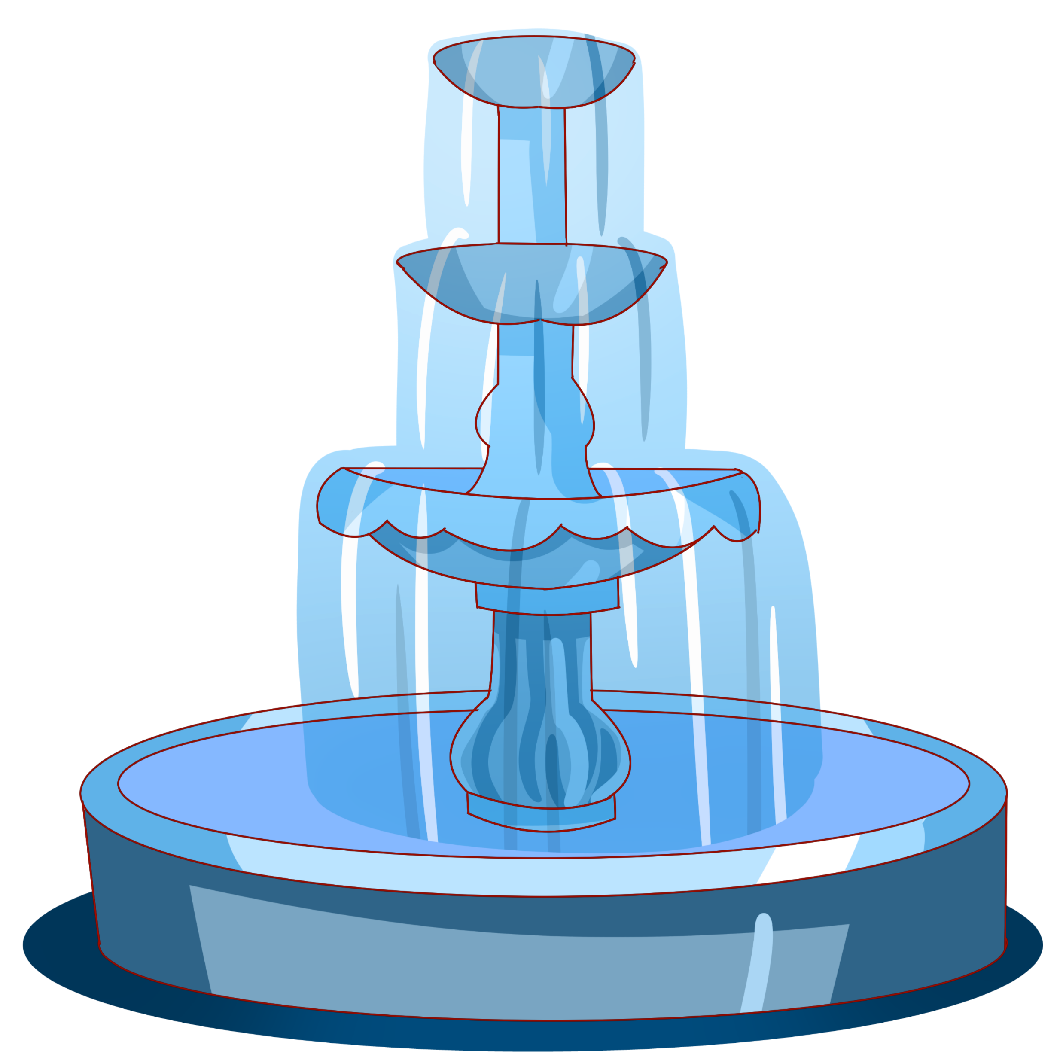
SMART WATER FOUNTAIN
IBM NAN MUDHALVAN –INTERNET OF THINGS
(GROUP-4)
PHASE-I Problem Definition and Design Thinking
DONE BY:
ARUN KUMAR.R (au82042106004)
DHINESH.R (au82042106012)
HARIHARASUDHAN.S (au82042106014)
MILTON EMIRATE RAJ.S (au82042106029)
MUKESH.M (au82042106030)

Slide 2
ABSTRACT
Water fountains have been a major tourist attraction these days which freeze the attention of tourists with their variety of lights, designs, and heights. And as we all know music holds a major part in our day-to-day lives.
And hence our idea is to combine the beautiful water fountain with music which makes an extraordinary tourist attraction when constructively set with a range of frequencies that enables us to operate through various electronic devices.
The project aims to enhance public water fountains by implementing IoT sensors to control water flow and detect malfunctions.

Slide 3
The primary objective is to provide real-time information about water fountain status to residents through a public platform.
This project includes defining objectives, designing the IoT sensor system, developing the water fountain status platform, and integrating them using IoT technology .
Musical water fountain consists of Arduino UNO, sound sensor with external MIC, submersible motors, LCD, relay modules, sound generation using mobile, ARGB LED light strip &adapters

Slide 4
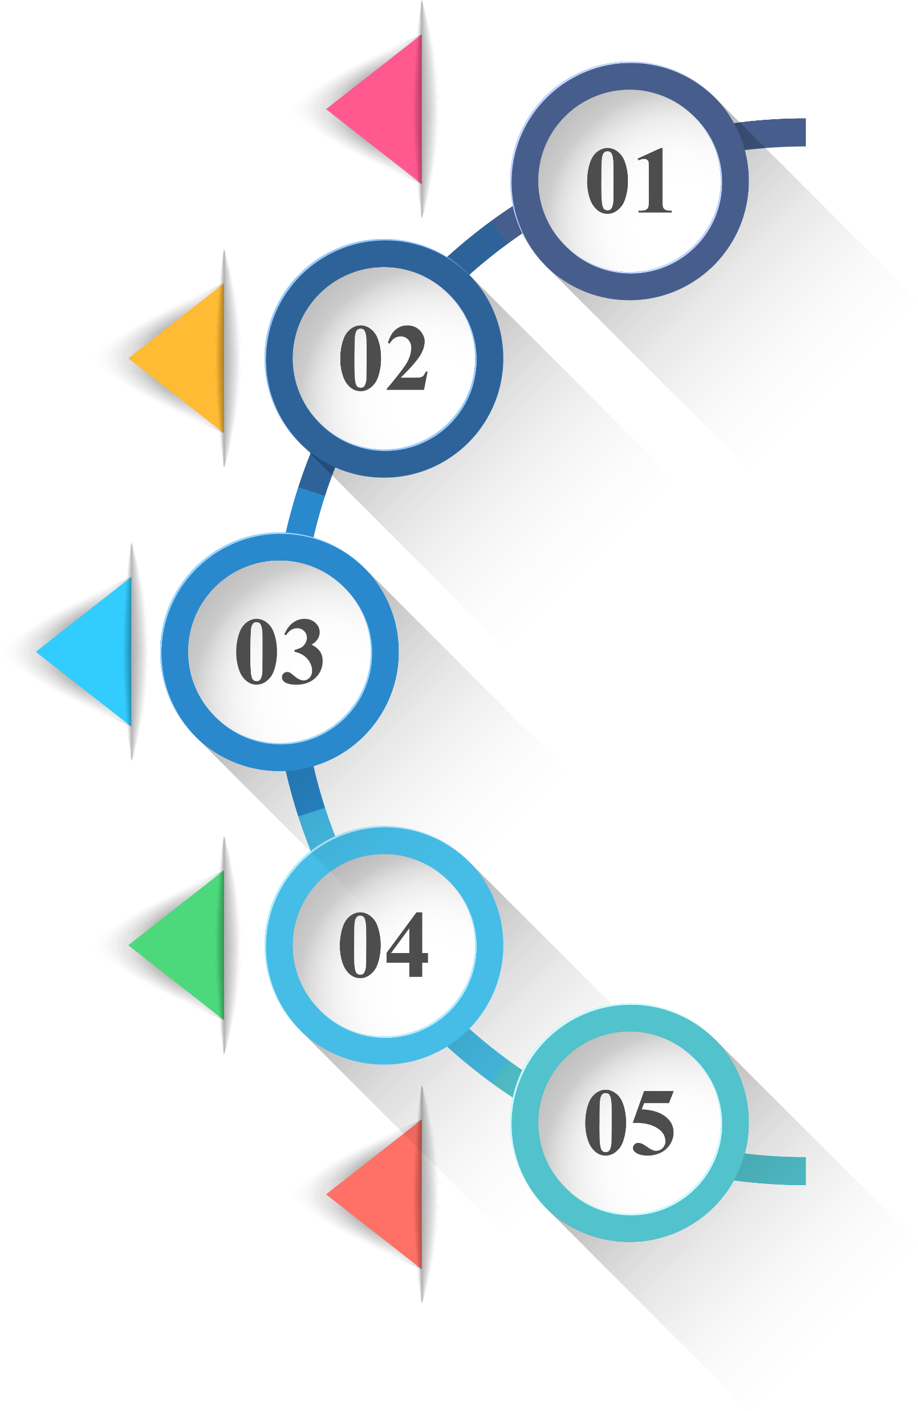
DESIGN THINKING:
Sensor Integration
Data Analytics and Processing
User Interaction and Control Water Conservation and Sustainability
Remote Maintenance and Diagnostics
Security and Privacy

Slide 5
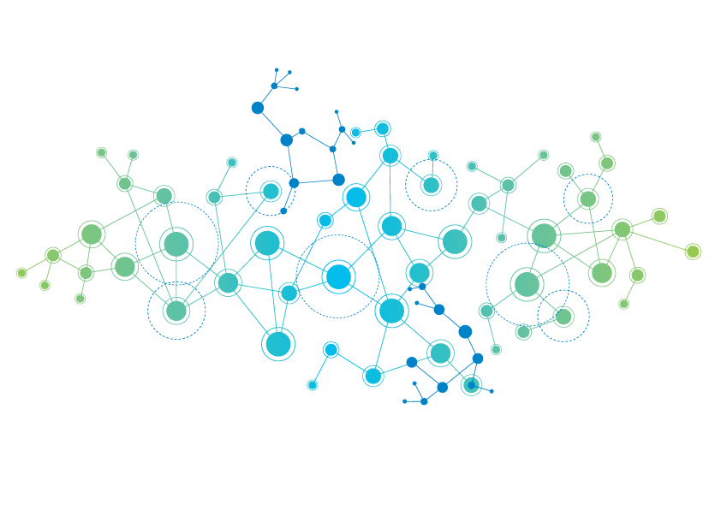
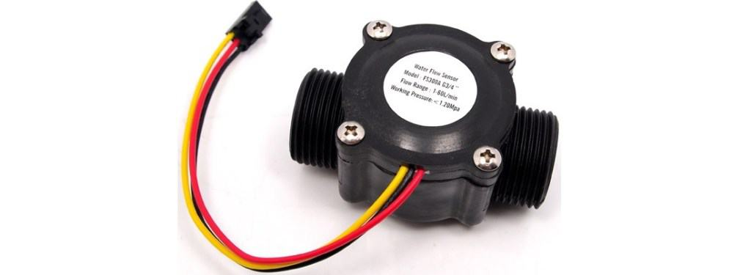
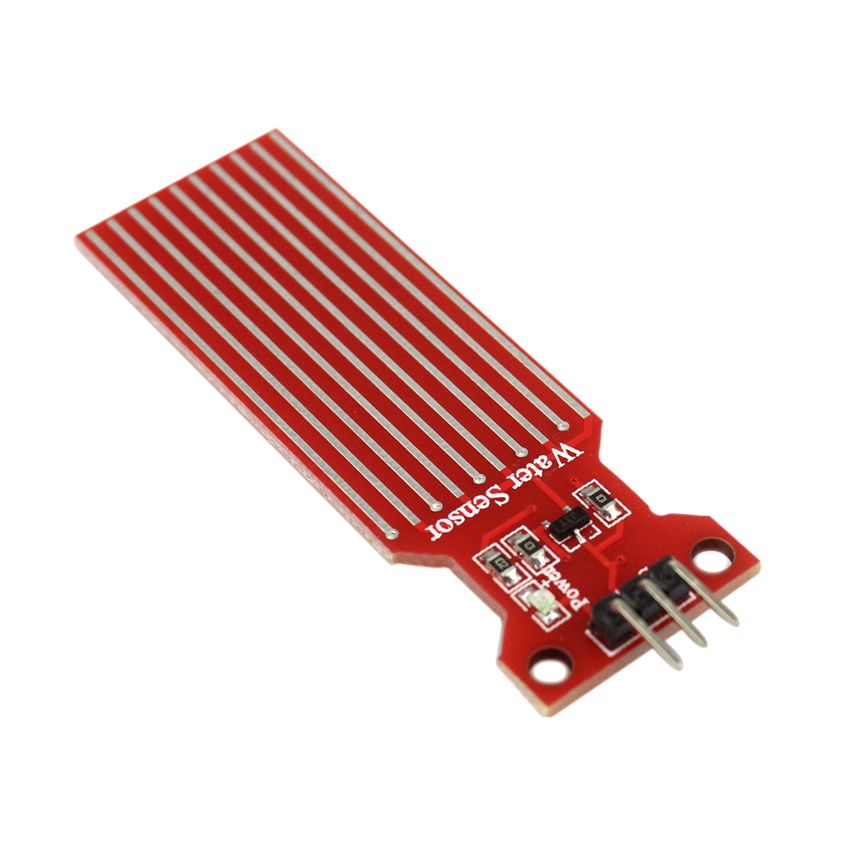
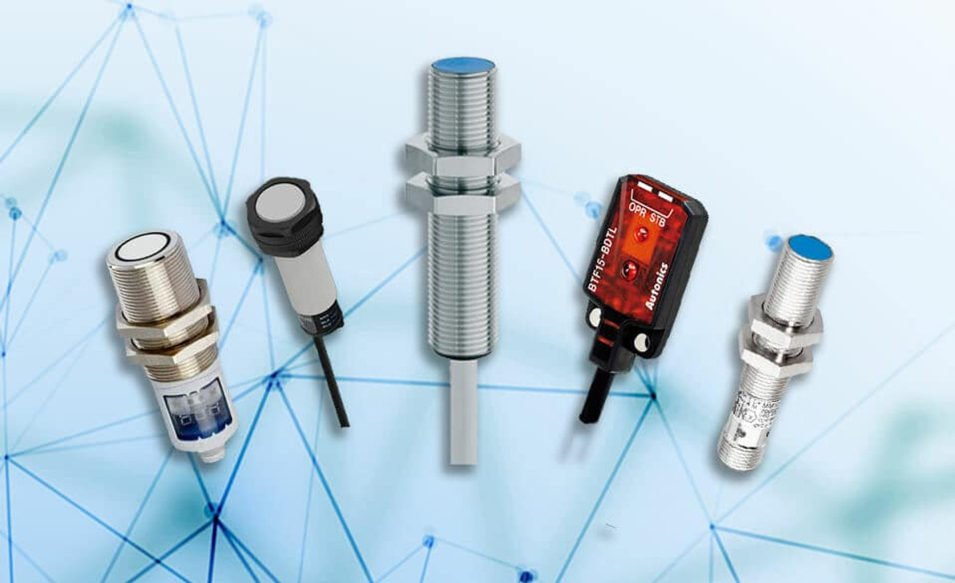
1. Sensor Integration
The Sensor Integration module is the foundation of our Smart Water Fountains system. It involves the installation of various sensors, such as water quality sensors, flow rate sensors, and proximity sensors, in and around the water fountain. These sensors continuously collect data, enabling real-time monitoring and analysis of water quality, usage patterns, and environmental conditions

Slide 6

2. Data Analytics and Processing
In this module, collected sensor data is processed and analyzed in real-time. Advanced data analytics algorithms are employed to detect anomalies in water quality, predict maintenance needs, and optimize water usage. Machine learning models can also be applied to identify usage trends, helping to improve fountain placement and resource allocation.

Slide 7

3. User Interaction and Control
The User Interaction and Control module offer an intuitive and user-friendly interface for both fountain users and administrators. Users can access the system via a dedicated mobile application or web portal to locate nearby fountains, check water quality, and receive real-time availability updates. Administrators gain control over fountain settings, allowing them to adjust water flow, monitor usage, and receive maintenance alerts.

Slide 8
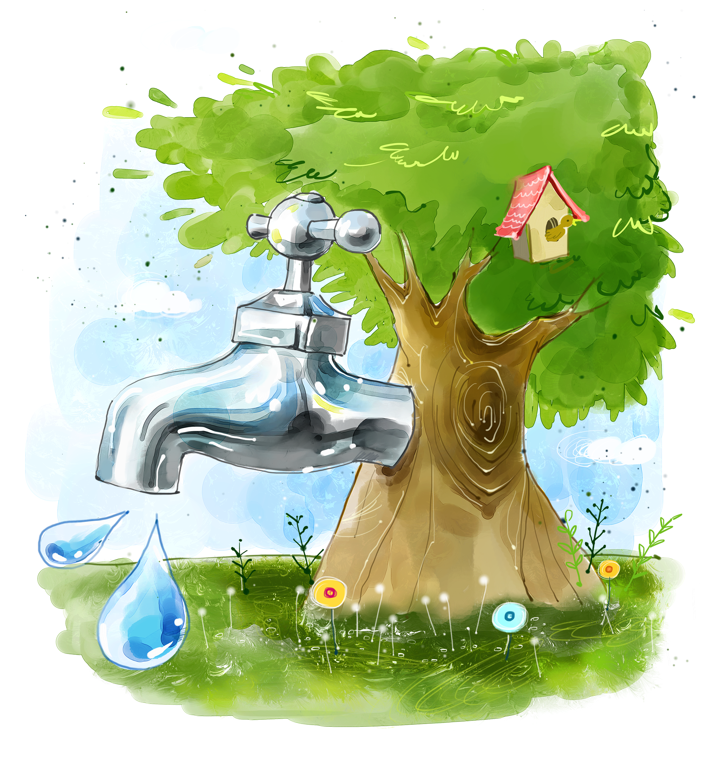
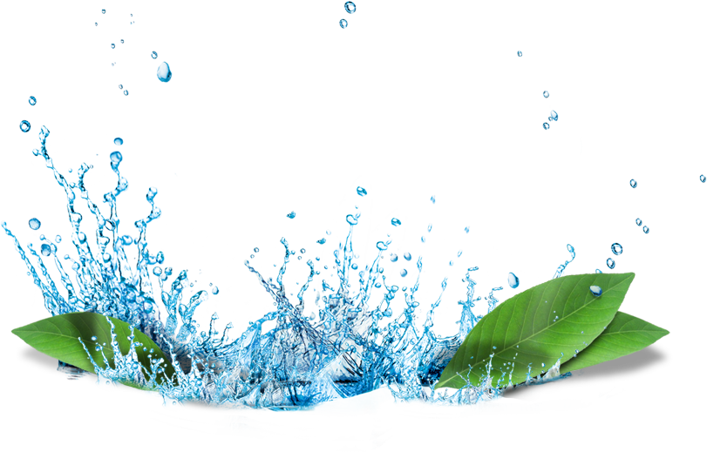
4.Water Conservation and Sustainability
One of the primary goals of our Smart Water Fountains system is to promote water conservation and sustainability.
This module focuses on implementing water
saving mechanisms, such as automatic shut
off during low usage hours, intelligent
scheduling, and feedback mechanisms to
encourage responsible water consumption.

Slide 9

5. Remote Maintenance and Diagnostics
Ensure the continuous operation of the Smart Water
Fountains, remote maintenance and diagnostics capabilities are integrated. Through IoT connectivity, administrators can remotely monitor fountain health, detect malfunctions,
and schedule maintenance tasks. This proactive approach reduces downtime and enhances overall system
reliability.
To

Slide 10


6.Security and Privacy
The Security and Privacy module is a critical aspect of our system. Robust security measures, including encryption, authentication, and access control, are implemented to protect user data and prevent unauthorized access. Privacy concerns are addressed through transparent data handling practices and compliance with relevant regulations.

Slide 11
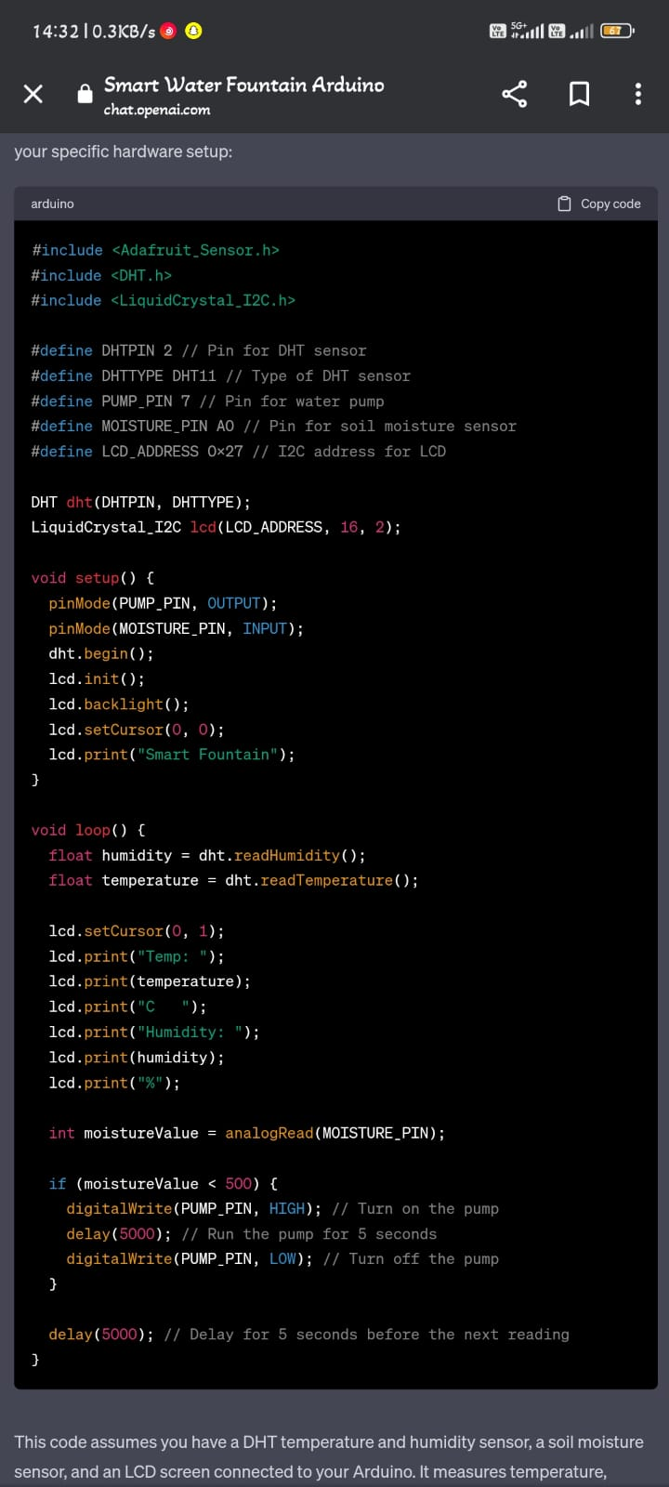
BASIC ARDUINO CODE FOR
SMART WATER FOUNTAIN

Slide 12
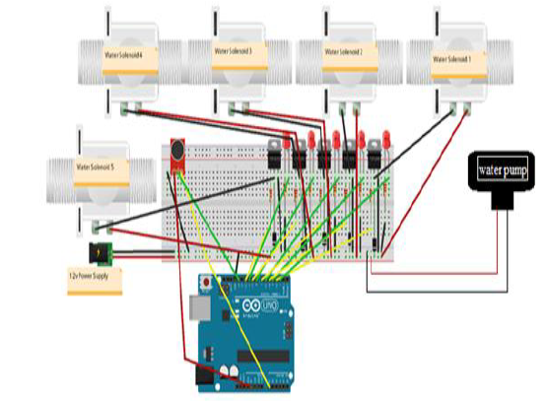
BASIC CIRCUIT
This code assumes you have a DHT temperature and humidity sensor, a soil moisture sensor, and an LCD screen connected to your Arduino. It measures temperature, humidity, and soil moisture. If the soil moisture falls below a certain threshold (500 in this example), it activates the water pump for 5 seconds to water the plants.Please note that this is a basic example, and you can enhance it with additional features like Wi-Fi connectivity for remote monitoring and control, scheduling, and more, depending on your project requirements. Also, ensure you have the necessary libraries installed in your Arduino IDE for the sensors and LCD display.

Slide 13
Conclusion:
The Smart Water Fountains Using IoT project represents a promising solution for improving water fountain efficiency and sustainability in public spaces. By integrating sensor technology, data analytics, user interaction, and water conservation mechanisms, this system offers numerous benefits, including reduced water waste, enhanced user experience, and simplified maintenance. With a focus on security and privacy, it aligns with the growing demand for responsible and data-driven water management in urban environments.

